Slide 1
Presentation: Zvorygin ‘Peak Oil’ chat - ver. 2, 12th June 2025
The ‘Million Dollar’ Oil Datasets:
- Comparing Public-domain Proved oil reserves with
Oil-industry Proved-plus-probable oil reserves
Dr. R. W. Bentley MEI
Former Editor ‘The Oil Age’ (www.theoilage.org);
Former Senior Research Fellow,
Dept. of Cybernetics, University of Reading, UK.
Forner Coordinator,
Oil Depletion Analysis Centre, London (‘ODAC’)
&
J. H. Laherrère
Former Head of Exploration Techniques, Total
Former President ASPO, France.

Slide 2
CAVEAT:
- It is true that the full datasets, including analysis, from the oil consultancies have an annual licence fee of ~$1 million, and these are (or were) bought by the oil majors.
- BUT: The full exploration and production (E&P) oil and gas datasets by field and by project have a typical annual licence fee of only ~$100,000.
- AND: These datasets can be bought by academic institutions and similar for sometimes considerably less.
- AND: The dataset from IHS Energy I used at ODAC (‘PEPS’) was by country (not by field and project), and cost only ~$5 k.

Slide 3
Two Types of Oil Dataset:
There are two types of oil dataset, with a huge difference
between them; and where this difference has misled oil
analysts for decades, and still misleads many today.
Datasets 1: Public-domain data on proved oil reserves, by
country, and as aggregated globally.
From: US EIA, OPEC, Oil & Gas Journal, World Oil,
Statista, ‘Our World in Data’, and formerly BP Stats.
Review. These are almost invariably the oil reserves data
presented in research reports and in the media.
Never, ever, use these data!

Slide 4
Datasets 2: Oil industry data on backdated proved
-plus-probable oil reserves by field and project,
and as aggregated by country, and globally.
From: Oil companies, some governments (UK,
Norway; but be careful which datasets you
access), and oil consultancies, including
Petroconsultants (later IHS Energy, now S&P);
Wood Mackenzie, Globalshift.co.uk, and most
recently, Rystad Energy.
These are the ‘$100,000’ datasets
- Use only these data!
[N.B. Globalshift.co.uk data can be less expensive.]

Slide 5
So, what’s the difference?
Datasets 1: Public-domain proved (‘1P’) oil reserves are:
underestimated, often badly overestimated, and annual
changes in reserves are often not reported, sometimes
not for decades!
Datasets 2: Oil-industry proved-plus-probable (‘2P’) oil
reserves are fairly reliable, though even here caution is
needed - see next slide.

Slide 6
Possible problems with Oil Consultancy 2P reserves data include:
- IHS PEPS ‘2P’ data used to include only 1P reserves for the US, except for Gulf of Mexico fields where the reserves were 2P.
- Some datasets, for the Former Soviet Union (FSU) countries, gave ‘ABC1’ oil reserves. These reserves are sometimes judged as nearer proved-plus-probable-plus-possible (‘3P’) than 2P.
- Where datasets (such as Rystad’s) provide 1P oil reserves by region, such as for OPEC or the world, totals by simple summation are statistically incorrect; the ‘true’ 1P reserves would be larger.
- Rystad terms their ‘2PCX’ category ‘reserves’. This is not correct, as ‘reserves’ should not include yet-to-find.
- Rystad recently also provided the ‘life’ of reserves, i.e., the number of years the reserves would last if oil production stayed at the current level. This is very misleading, as more than half the countries of the world are already past their resource-limited oil production peak and their production is in decline. And many of the ‘not-yet-past-peak’ countries will also soon reach production peak and then see decline.

Slide 7
Now let’s examine the difference: 1P vs. 2P – (i).
Public-domain proved (‘1P’) oil reserves (in red) vs. Rystad
Energy estimates (in black) for proved (‘1P’) oil reserves,
proved-plus-probable (‘2P’) reserves, 2P plus contingency
(‘2PC’), and 2PC plus potential exploration finds (‘2PCX’):
[Gb; 1P reserves: BP ‘Stats. Rev.’; Rystad: July 2024 data.]
US N’wy Iran Iraq Kuwait Canada Venez. World
1P: 67 8 158 145 102 168 304 1732
1P: 32 5 27 31 18 34 5 449
Mult. x2 - x6 x5 x6 x5 x60 x4
2P: 44 7 48 58 31 45 9 738
2PC: 102 11 78 100 45 110 26 1224
2PCX: 156 15 86 106 48 122 29 1536
Mult. - - x1.8 x1.4 x2.1 x1.4 x10.5 x1.1
Conclusion: Never, ever use public-domain 1P data!

Slide 8
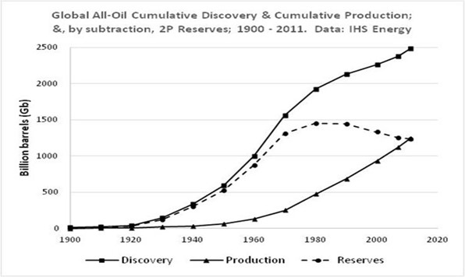
The difference: 1P vs. 2P – (ii).
- Even more important than actual differences is the evolution over time of the two types of data.
- Plot of oil-industry cumulative 2P discovery, cumulative production, and hence - by subtraction - 2P oil reserves:
From 1900 to about 1970, global annual oil discovery raced ahead of annual production, putting significant 2P oil reserves ‘in the bank’. But from 1985 annual production exceeded annual discovery, and global 2P oil reserves started to decline.

Slide 9
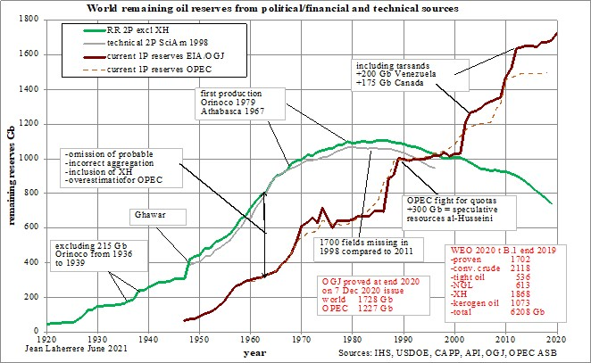
The difference: 1P vs. 2P – (iii).
Public-domain 1P reserves (red): ‘ever-upward’ vs. Oil-industry
2P reserves (green) peaked in 1985, & now in decline.

Slide 10
Who has had access to the oil-industry 2P data?
Authors on ‘peak oil’ who have had access to the oil-industry data include the following, with their sources of these data shown in parentheses: Hubbert (Wallace Pratt’s and later industry data), Campbell and Laherrère (Petroconsultants data, and later the IHS Energy EDIN database); Miller (BP data for the company’s bottom-up oil forecast model, and subsequently for the UKERC 2009 Global Oil Depletion study and as provided to McGlade); Bentley and co-authors’ papers on global oil supply, and ‘Introduction to Peak Oil’ (IHS data, and their ‘PEPS’ by-country year-2000 E&P dataset when Bentley was employed at the Oil Depletion Analysis Centre in London); Michael Smith (globalshift.co.uk data); Robelius (oil industry data in the public domain); UKERC’s Global Oil Depletion study (data from Miller and Bentley, and purchase of the ‘PEPS’ dataset); Uppsala University and the Shift Project (Rystad’s E&P database); and the IEA (Rystad’s database, but where the IEA makes clear that they use these data in their analyses, but their forecasts reflect a range of demand scenarios). For a more detailed discussion of public-domain and oil-industry oil reserves, and recoverable oil resources data, see Laherrère et al. (2022).

Slide 11
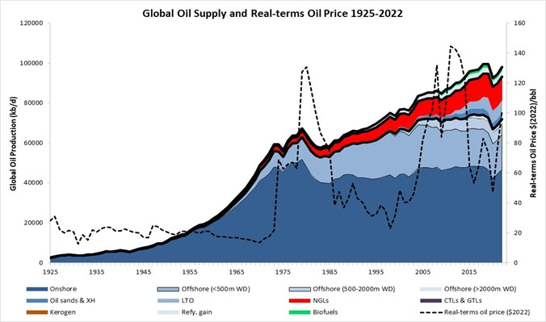
To access oil-industry 2P data: S&P ‘PEPS’, Rystad press
releases, & charts by Laherrère and globalshift.co.uk.
Global supply of conventional oil has been at essentially resource-limited plateau since 2005. Additional oil since then has had to come from NGLs and the generally more expensive non-conventional oils.
Sources: globalshift.co.uk & EI Stats.

Slide 12
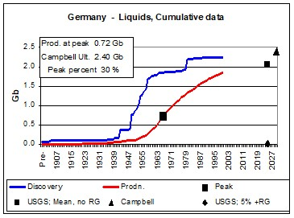
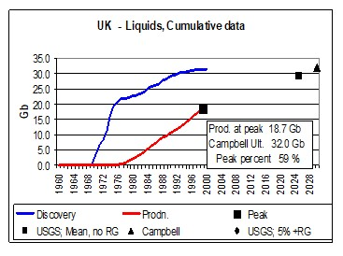
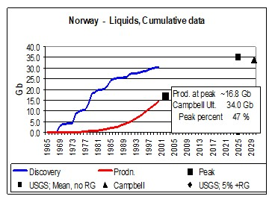
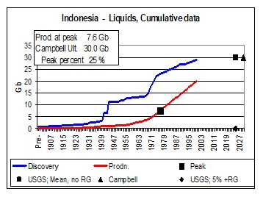
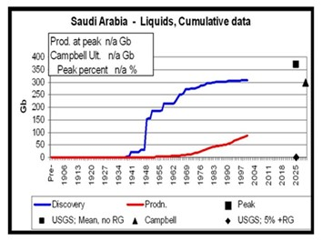
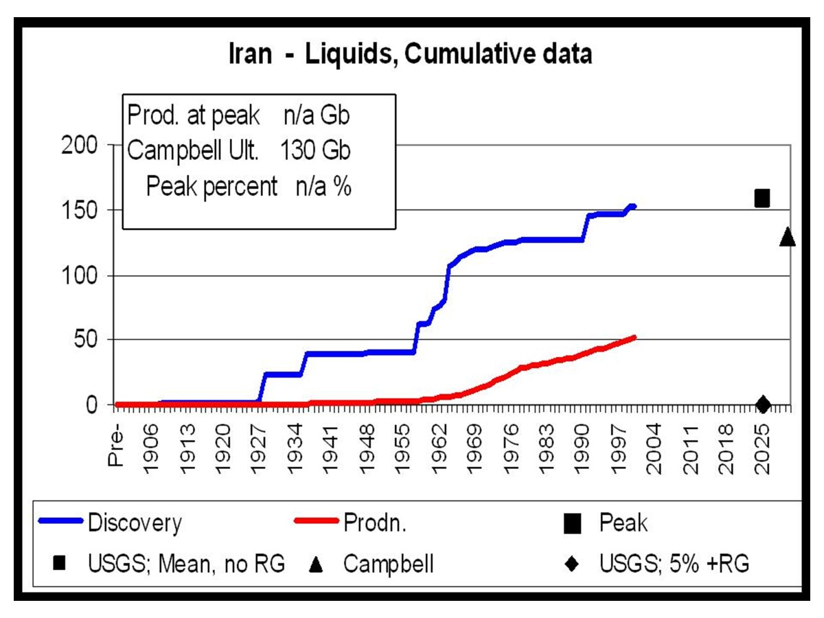
Six Examples:
Oil-consultancy backdated 2P oil discovery data indicating each country’s likely ultimately recoverable resource (URR) of oil, and hence expected date of resource-limited peak oil production.
[Data: IHS Energy ‘PEPS’ yr. 2000.]

Slide 13
Further reading (i):
1. Yergin, D. (1990). ‘The Prize: The Epic Quest for Oil, Money, and Power’. Simon & Schuster.
This book well deserved its Pulitzer Prize, and is an outstanding introduction to the broad panorama of oil development since its beginnings. But it must be noted that Yergin nowhere references Hubbert, and seems essentially unaware of the phenomenon of oil ‘peak production at mid-point’. So, in his chapter on the US reaching its resource-limited production peak of conventional oil in 1970, and hence the ending of US prorationing and the consequent oil shocks of the 1970s, Yergin has no recognition that Hubbert and a number of others had correctly foreseen this peak.
2. Campbell, C.J. and Laherrère, J. (1998). ‘The End of Cheap Oil’. Scientific American, March.
If you only read one reference on oil data, oil forecasting, and predicting oil price, this is the one. It is based on the three detailed consultancy reports commissioned by Petroconsultants from 1994 to1996 which used the Petroconsultants (later, IHS Energy) oil and gas exploration and production (E&P) database, widely recognised at the time as the best global source for such data. This article combined these data with both standard and innovative modelling to assess ultimately recoverable resources (URRs) of conventional oil by country, and combined these URR estimates with ‘peak at mid-point’ modelling to forecast future conventional oil production; but declining production post-peak exponentially, rather than by a symmetric ‘Hubbertian’ curve. The paper correctly forecast the date when global production of conventional oil would reach its essentially resource-limited maximum for oil prices up to well above $100/bbl, and showed that this would indeed be ‘the end of cheap oil’.
3. Campbell, C.J. (Ed.) (2011). ‘Peak Oil Personalities’. Inspire Books, Skibbereen, Ireland.
This is just an extraordinary book. It has 26 contributors, where each recounts how their career (often, but not always, within the oil industry) developed, and how - sometimes reluctantly! - they came to understand ‘peak oil’. Contributors include Ugo Bardi, Jean-Marie Bourdaire (with surprising insights as to how the IEA approached the sensitive topic of peak oil), Colin Campbell, Jeremy Gilbert, Jean Laherrère Alain Perrodon, Jörg Schindler, Chris Skrebowski, Walter Ziegler and many other luminaries in the field. It is a must-read for those wishing to understand peak oil, but also for those who wish to investigate how ideas propagate across society, and the difficulties such propagation sometimes faces.

Slide 14
Further reading (ii):
4. Auzanneau, M. (2018). ‘Oil, Power, and War’. Chelsea Green. (Originally: ‘Or noir - La grande histoire du petrole’, published 2015 by La Découverte; and translated into English by John F. Reynolds.)
This is another outstanding book on the history and importance of oil, which one reviewer said: “… presents a comprehensive, provocative history of humankind’s relationship with oil.” In the book’s foreword, Richard Heinberg explains why he believes Auzanneau’s history to be superior to Yergin’s, including Auzanneau’s being ‘a people’s history’; highlighting the critical role energy plays in shaping societies and economies; and in understanding that oil’s history represents a cycle with a beginning, middle and end. The book brings to light numerous dramatic, and often very surprising and dark, events in the history of oil.
5. Inman, M. (2016). ‘The Oracle of Oil. A Maverick Geologist's Quest for a Sustainable Future’. W.W. Norton and Company.
This excellent biography of M. K. Hubbert describes his life, his work on likely recoverable volumes of mineral resources (including oil) and hence their future production; and sets out his views on the need for a more rational system of economics and government; a view developed from witnessing first-hand the economic meltdown of the Great Depression and its severe social consequences. As the publisher notes:
“In 1956, geologist and Shell Oil researcher Marion King Hubbert delivered a speech that has shaped world energy debates ever since. Addressing the American Petroleum Institute, Hubbert dropped a bombshell on his audience: U.S. oil production would peak by 1970 and decline steadily thereafter. World production would follow the same fate, reaching its peak soon after the turn of the millennium.”
[N.B. Inman is currently Data Director at Global Energy Monitor, a non-profit organisation tracking fossil-fuel projects around the world to aid the transition to clean energy.]
6. Bentley, R.W. (2023). ‘Colin Campbell, Oil Exploration Geologist and Key Proponent of ‘Peak Oil’’. Biophysical Economics and Sustainability (2023) 8:3; https://doi.org/10.1007/s41247-023-00111-x
This paper describes the career of Dr. Colin Campbell; sets out how he came to understand peak oil when many of his colleagues in similar jobs did not; explains they key approaches used by Campbell together with Jean Laherrère to unravel the future of oil supply; and lists some of Campbell’s many efforts to get the information about peak oil more widely known.
[Note: A selection of Dr. Campbell’s papers is held in the Special Collections section of the Boole library of University College Cork, Ireland.]

Slide 15
Conclusions
- By using the misleading public-domain proved (‘1P’) oil
reserves data, analysts have long said: ‘Don’t worry
about oil supply, reserves are always increasing’.
– This is just tosh!
- Use instead the oil-industry backdated data on proved-
plus-probable (‘2P’) oil discoveries, and hence ‘2P’
reserves.
- Maybe, just maybe, the Energy Institute in London will
hold an invite-only workshop on this important topic.

